Slide 1

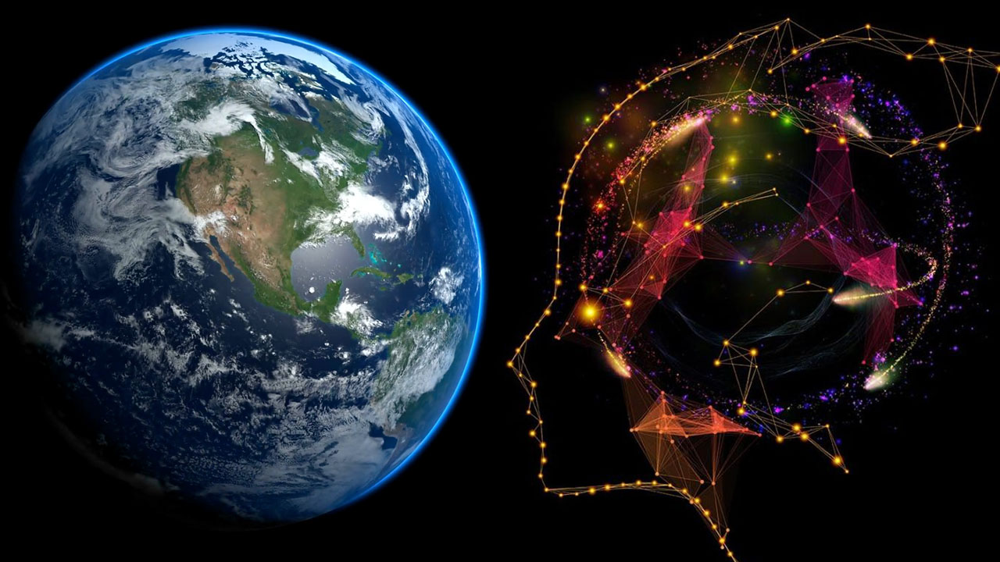
Spatial Machine Learning
Spatial Machine Learning Algorithms
Dr. Giri Rajasekhar Gunnu
Professor of Practice, Andhra University
📧 g.giri.iitm@gmail.com
🔗 LinkedIn: girigunnu

Slide 2
Introduction to Spatial Algorithms & Spatial Regression
1

Slide 3
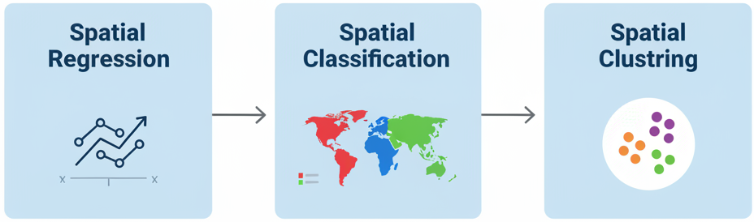
Overview: What We Will Learn
Spatial Regression: Moving beyond "one size fits all" models to understand how relationships change across space (Geographically Weighted Regression, Spatial Autoregressive Models).
Spatial Classification: Adapting powerful classifiers like Decision Trees and SVMs to leverage spatial information.
Spatial Clustering: Discovering natural groupings and hotspots in geographic data using algorithms like DBSCAN and Spatial K-Means.

Slide 4
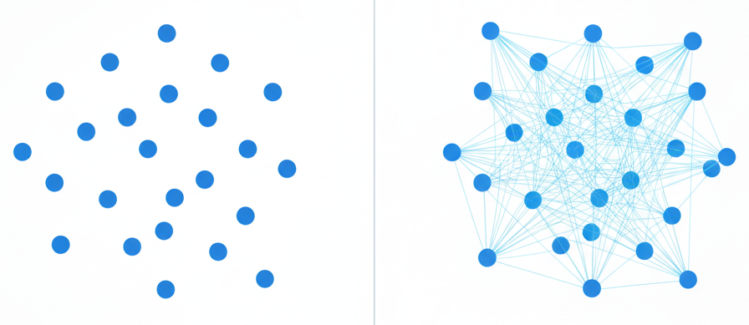
Why Do We Need Special Spatial Algorithms?
Concept: Standard machine learning models assume independence of observations.
The Spatial Reality: In geography, this is rarely true due to spatial autocorrelation (Tobler's First Law). The value of a feature (e.g., house price) is often influenced by its neighbors.
The Consequence: Ignoring this dependency leads to biased models and inaccurate predictions. Spatial algorithms are designed to embrace and model this dependency.

Slide 5
Learning Objectives
Objective 1 (Theory): Differentiate between global and local spatial models and understand the concept of spatial non-stationarity.
Objective 2 (Practical): Implement and interpret the results of Geographically Weighted Regression (GWR) and Spatial Autoregressive (SAR) models.
Objective 3 (Application): Adapt and apply traditional classification and clustering algorithms to solve real-world geospatial problems.

Slide 6
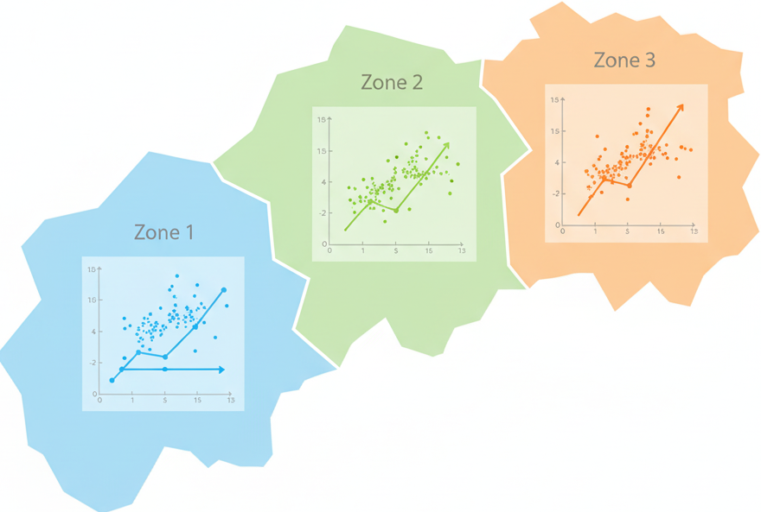
Spatial Regression Models
Modeling Relationships that Vary Across Space
Key Question: Does the relationship between variables (e.g., education and income) stay the same everywhere in our study area, or does it change?

Slide 7
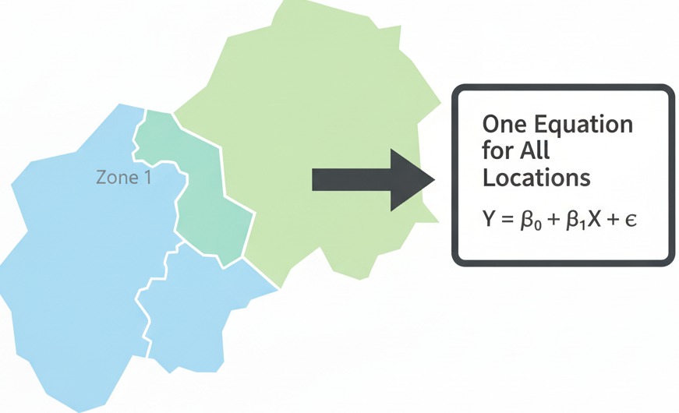
The Problem with Standard Regression (OLS)
Concept: Ordinary Least Squares (OLS) regression is a global model. It calculates a single equation to describe the relationship between variables for the entire dataset.
Equation: Y = β₀ + β₁X₁ + ... + ε
The Limitation: It assumes the relationship (the β coefficients) is stationary—constant across space. This is often a flawed assumption in geography.

Slide 8
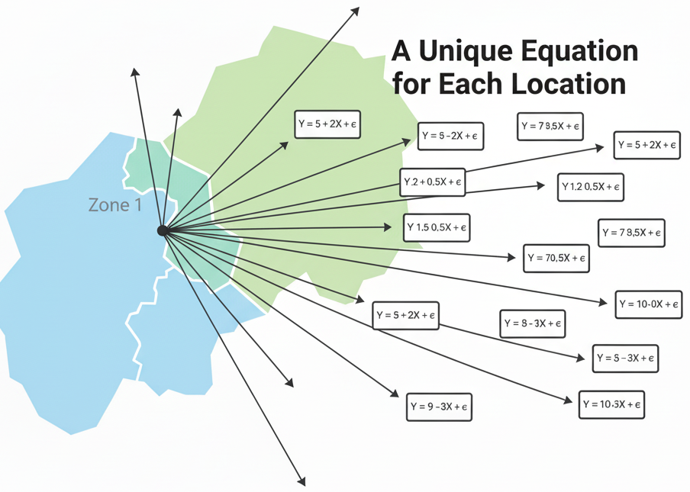
Introducing Geographically Weighted Regression (GWR)
Concept: GWR is a local model. Instead of one global equation, it fits a unique regression equation for every single data point in the dataset.
How: It gives more weight to nearby data points when making a prediction for a target point, and less weight to distant points.
The result: The coefficients (β) are no longer fixed numbers but can vary across the map, becoming functions of location (u, v).

Slide 9
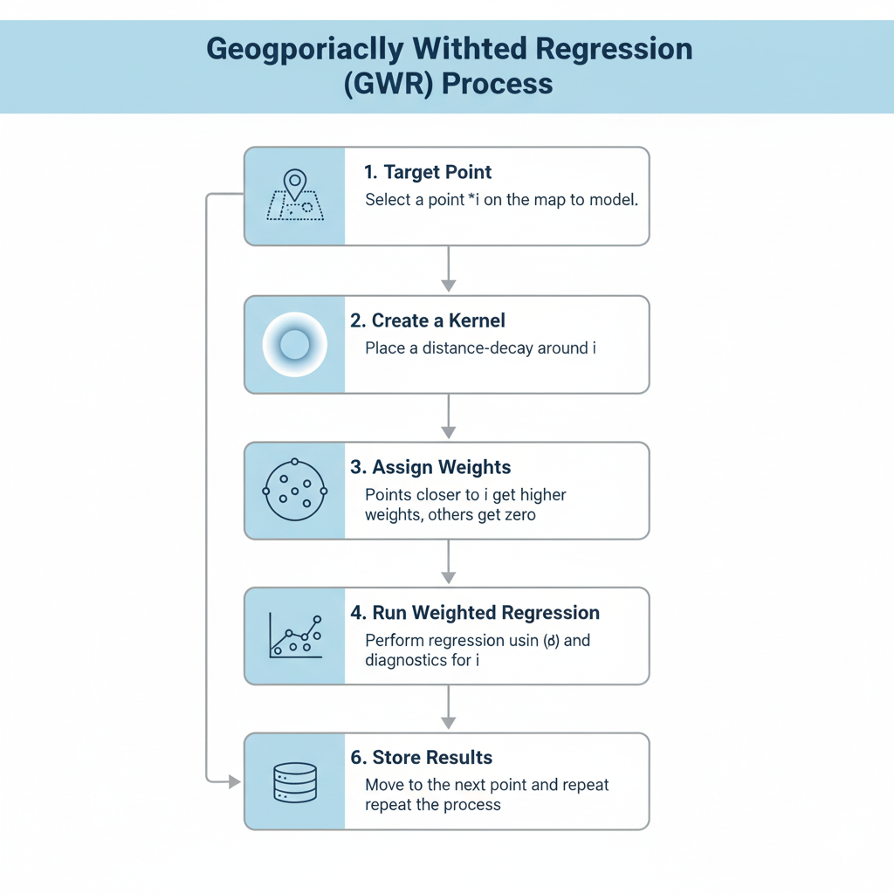
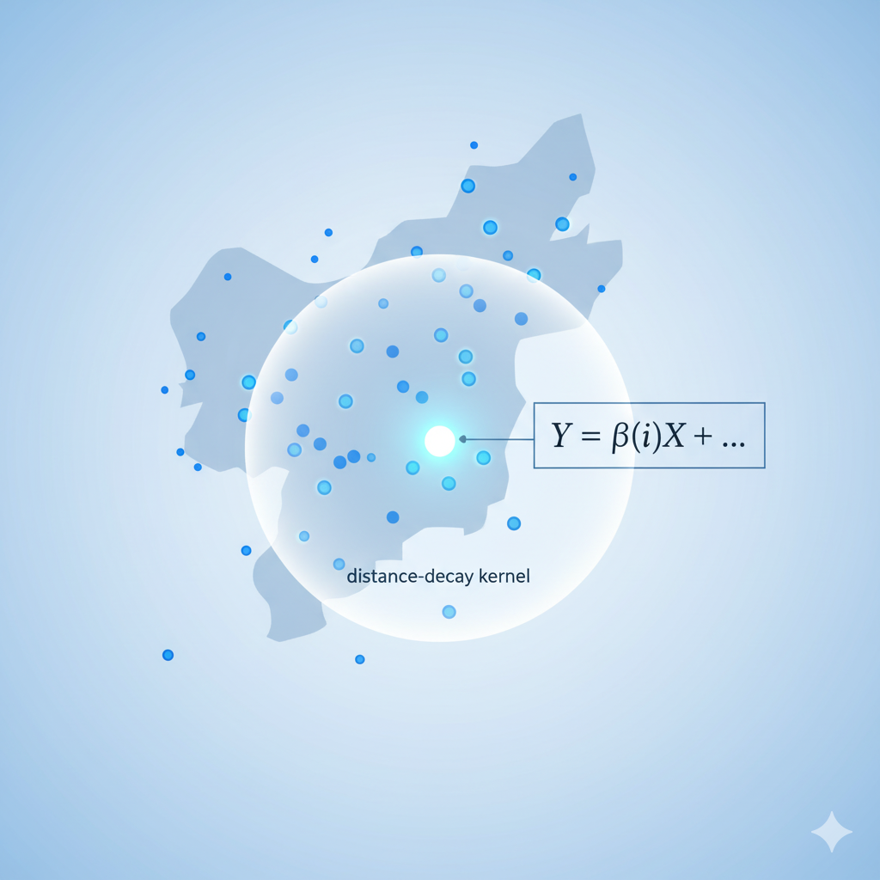
GWR: The Conceptual Model

Slide 10
The GWR Equation
From Global to Local
OLS Equation: Yᵢ = β₀ + β₁X₁ᵢ + εᵢ
GWR Equation: Yᵢ = β₀(uᵢ, vᵢ) + β₁(uᵢ, vᵢ)X₁ᵢ + εᵢ
Key Insight: The coefficients β now have a location (uᵢ, vᵢ) attached to them. This means the intercept (β₀) and the slope for each variable (β₁) can be different at every point i.

Slide 11
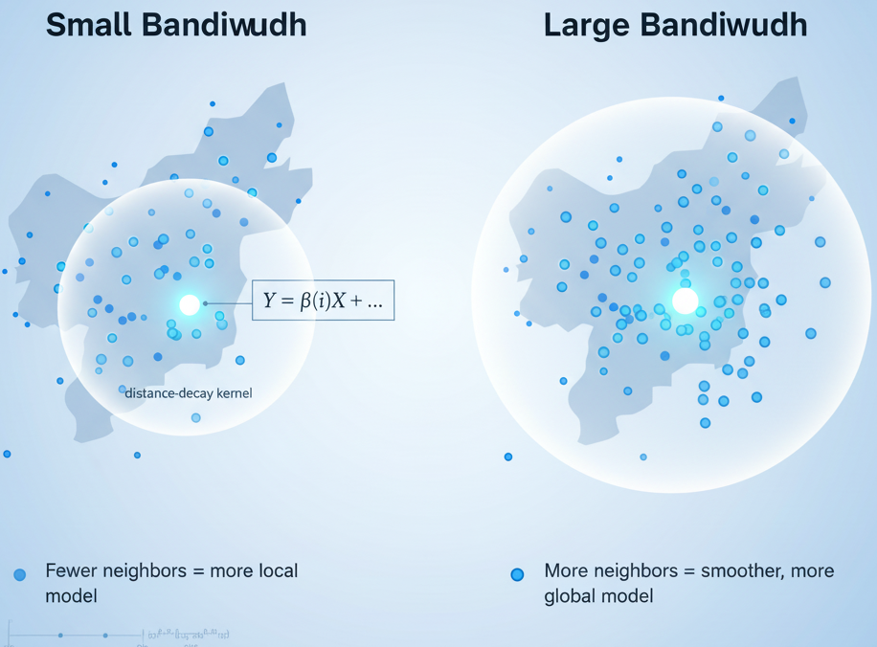
The Role of the Kernel and Bandwidth
The Kernel: A function that determines how weights decrease with distance. Common choice: Gaussian kernel.
The Bandwidth: The most critical parameter in GWR. It controls the size of the kernel.
Small Bandwidth: Uses only very local data. Results in coefficients that vary rapidly.
Large Bandwidth: Uses more distant data. Results in smoother, more global-like coefficients.

Slide 12
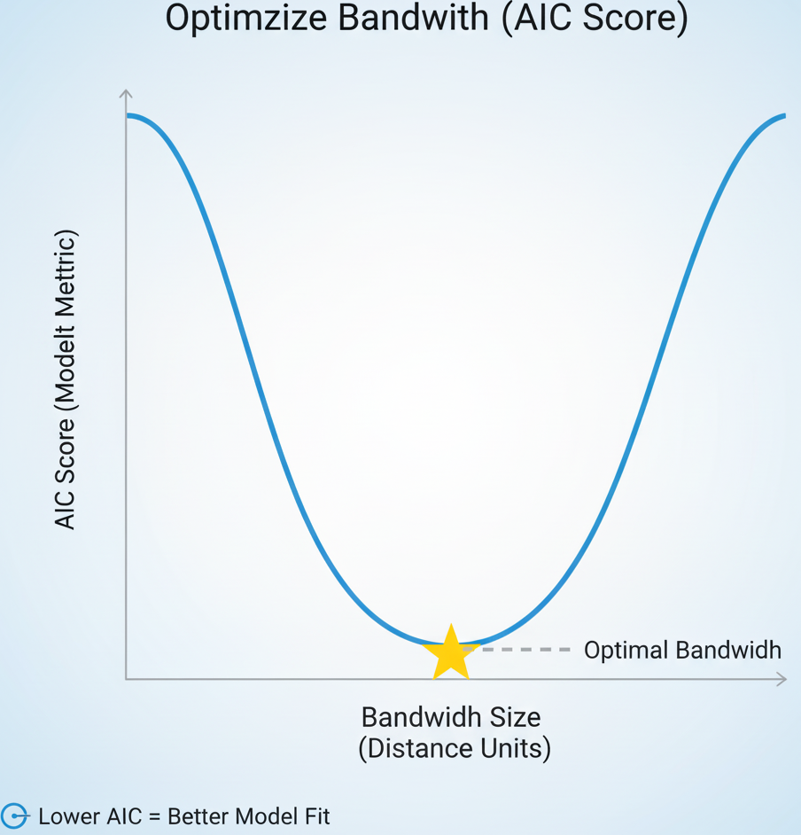
Choosing the Optimal Bandwidth
Concept: This is a data-driven process. We want a bandwidth that provides the best model fit without being too complex.
Methods:
Cross-Validation (CV): Remove a point, predict its value using a certain bandwidth, calculate the error. Repeat for all points. The bandwidth with the lowest total error wins.
Akaike Information Criterion (AIC): A statistical measure that balances model fit and model complexity. We typically choose the bandwidth that minimizes the AIC score.

Slide 13
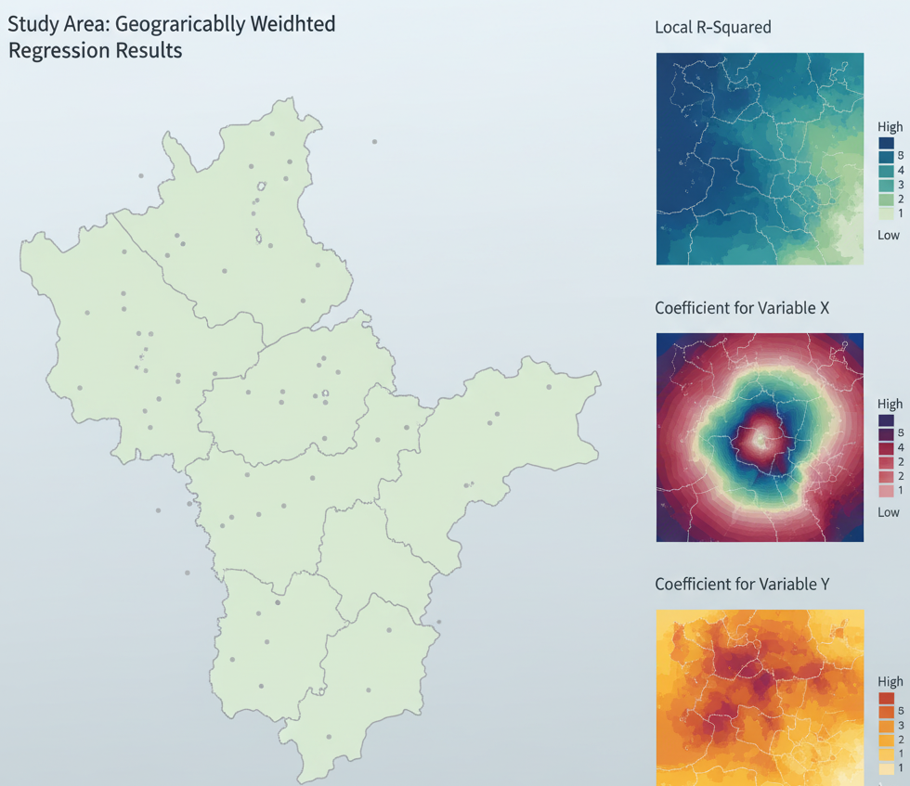
Interpreting GWR Results
The Power of GWR: The output is not just a single set of numbers. The outputs are maps
What you can map:
A map of the local R-squared values (showing where the model predicts well or poorly).
A map of the local intercept values.
A map for each predictor variable's local coefficient (β₁, β₂, etc.), showing where that variable has a strong positive, strong negative, or negligible effect.

Slide 14
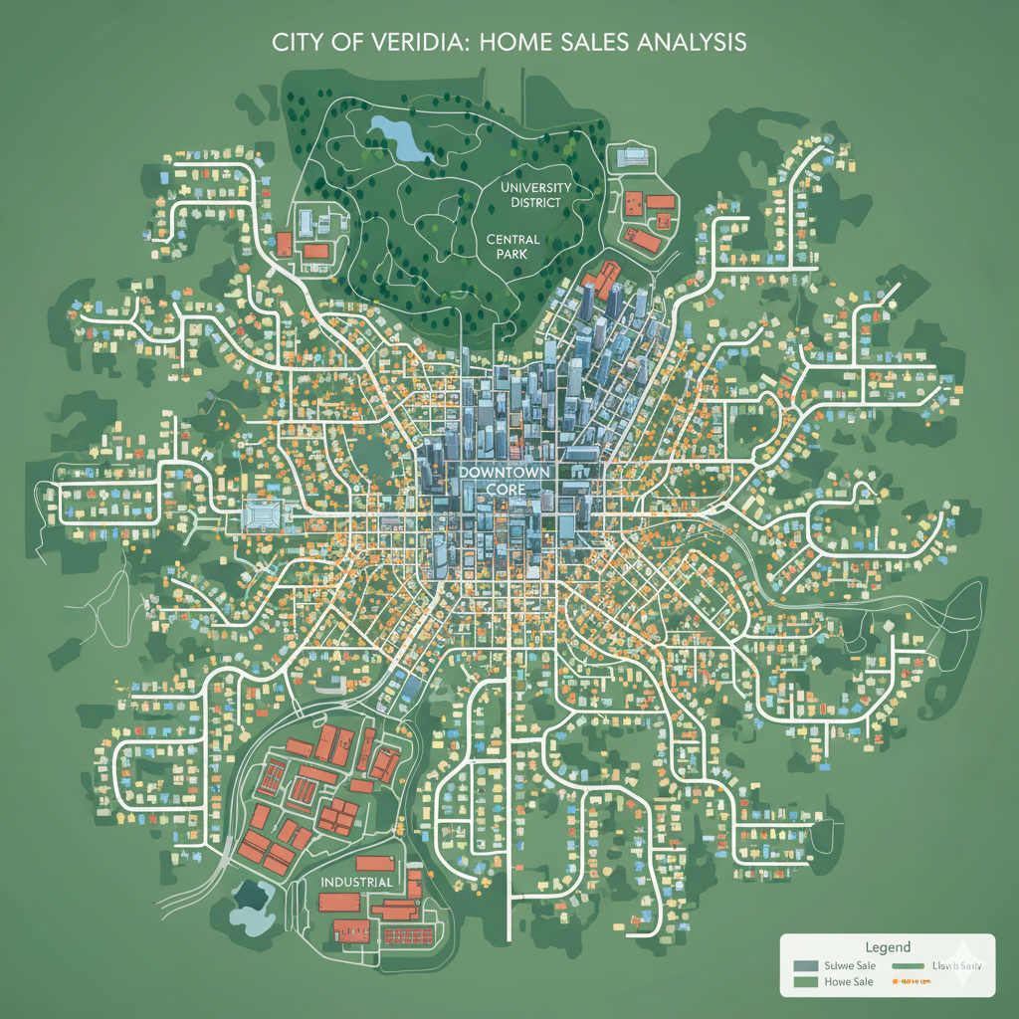
Case Study Setup: Predicting House Prices
Objective: To understand what drives house prices in a city and if those drivers are consistent across all neighborhoods.
Dataset: A point layer of recent home sales.
Variables:
Dependent (Y): Sale_Price
Independent (X): Square_Footage, Num_Bedrooms, Dist_to_Downtown

Slide 15
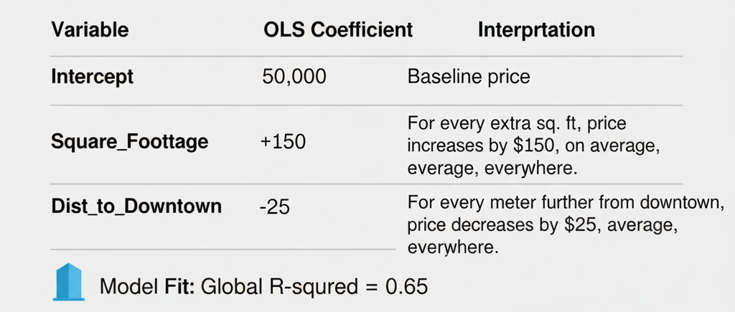
Case Study: OLS Global Model Results

Slide 16
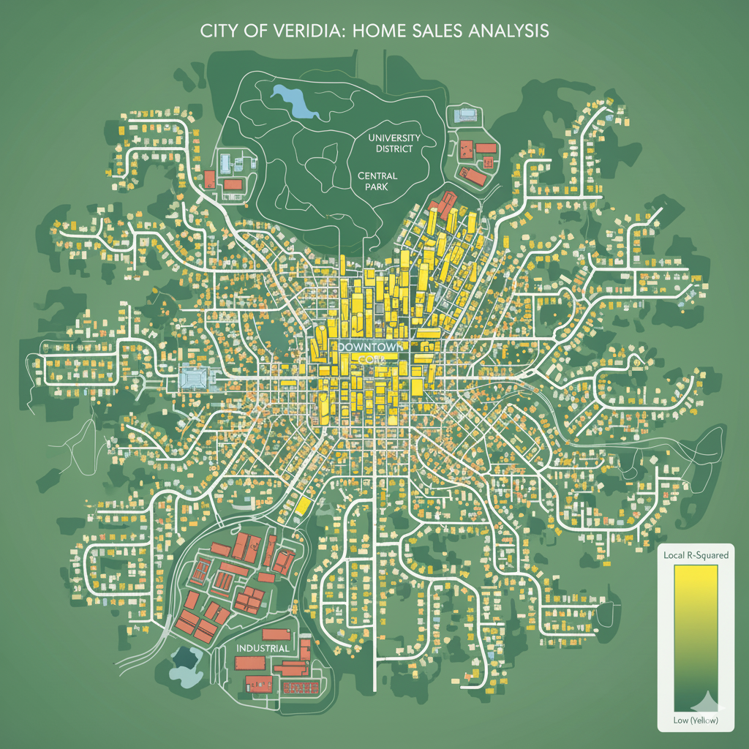
Case Study: GWR Local Model - Mapping R-Squared
Concept: Now we run GWR. The first thing we check is where the model is performing well.
Visualization: A choropleth map of the local R-squared values.
Interpretation: We might find the model works very well (R² > 0.80) in the established suburbs but poorly (R² < 0.40) in the rapidly changing downtown core where other factors (like view, new construction) are at play.

Slide 17
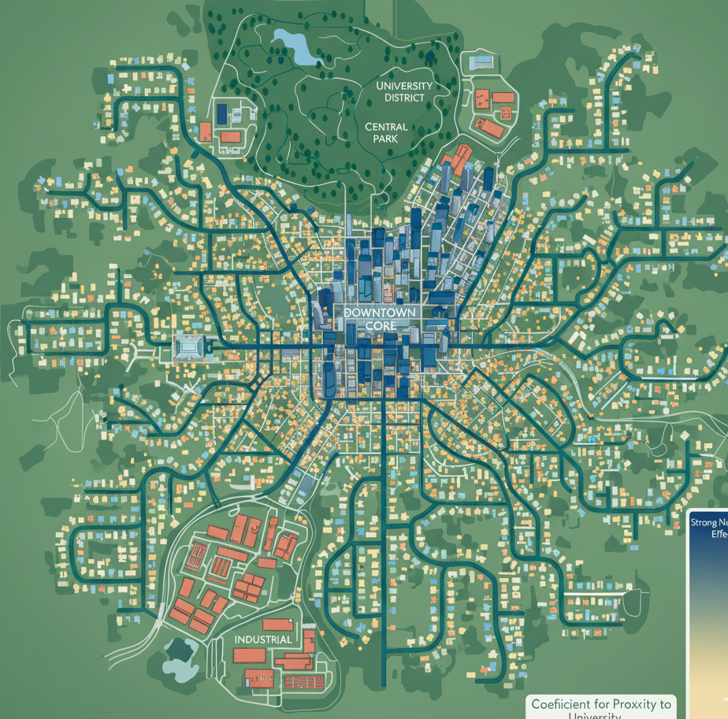
Case Study: GWR - Mapping the Dist_to_Downtown Coefficient
Concept: Let's visualize how the effect of being close to downtown varies.
Visualization: A choropleth map of the β coefficient for Dist_to_Downtown.
Interpretation:
Near the university district, the coefficient might be strongly negative (students pay a premium for being close to downtown).
In the industrial district, the coefficient might be close to zero or even positive (proximity to the noisy/congested downtown is not a benefit).

Slide 18
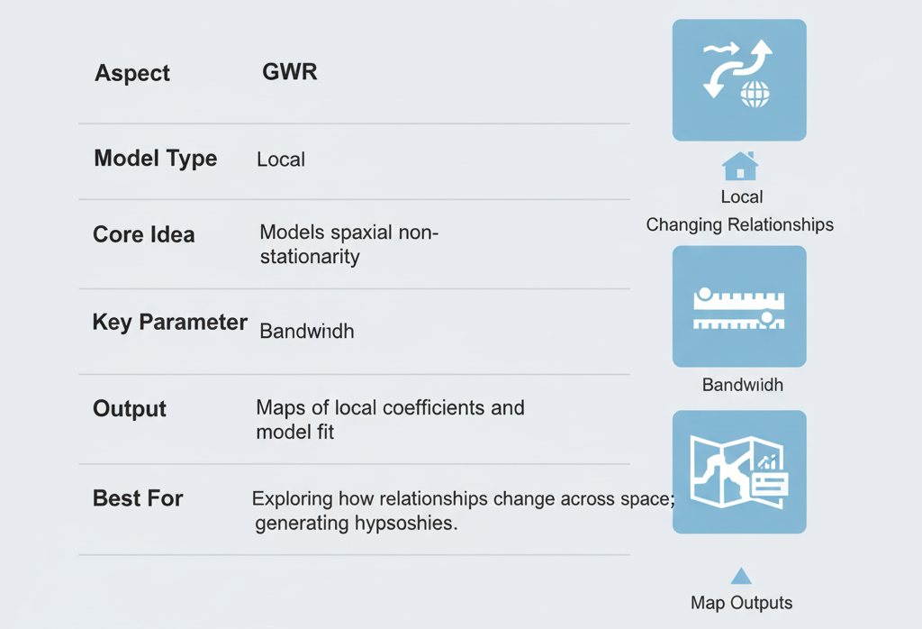
GWR Summary

Slide 19
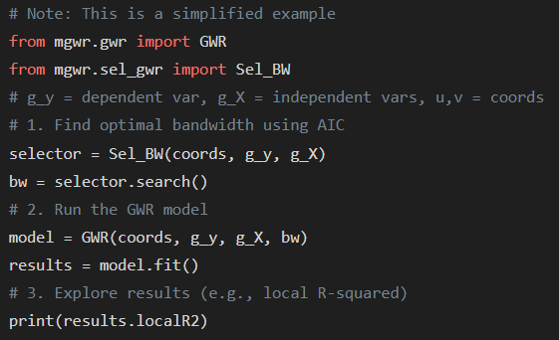
Python Code Snippet: Running GWR

Slide 20
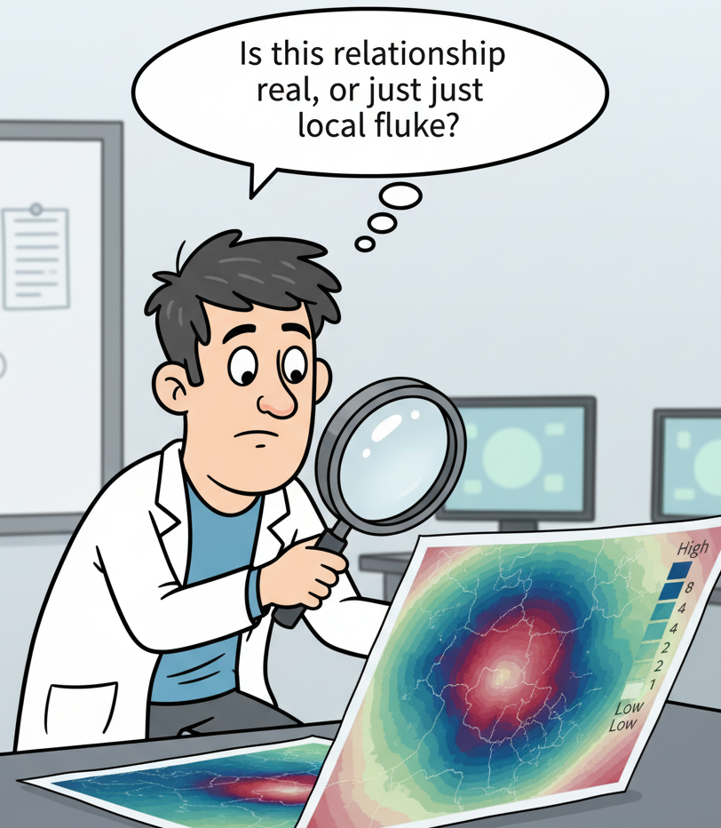
Limitations of GWR
Collinearity: GWR is sensitive to local collinearity (when two predictor variables are correlated in a specific part of the map).
Multiple Testing: Since you are running thousands of regressions, there's a risk of finding "significant" relationships just by chance.
Interpretation: It's primarily an exploratory tool, not a confirmatory one.

Slide 21
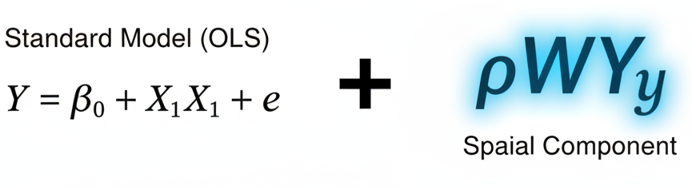
Introduction to Spatial Autoregressive (SAR) Models
Concept: A different way to handle spatial dependence. Instead of modeling changing relationships like GWR, SAR models explicitly include a term for the "neighborhood influence" in a global regression equation.
Analogy: It's like a standard OLS model, but with a new "spatial" predictor variable added.

Slide 22
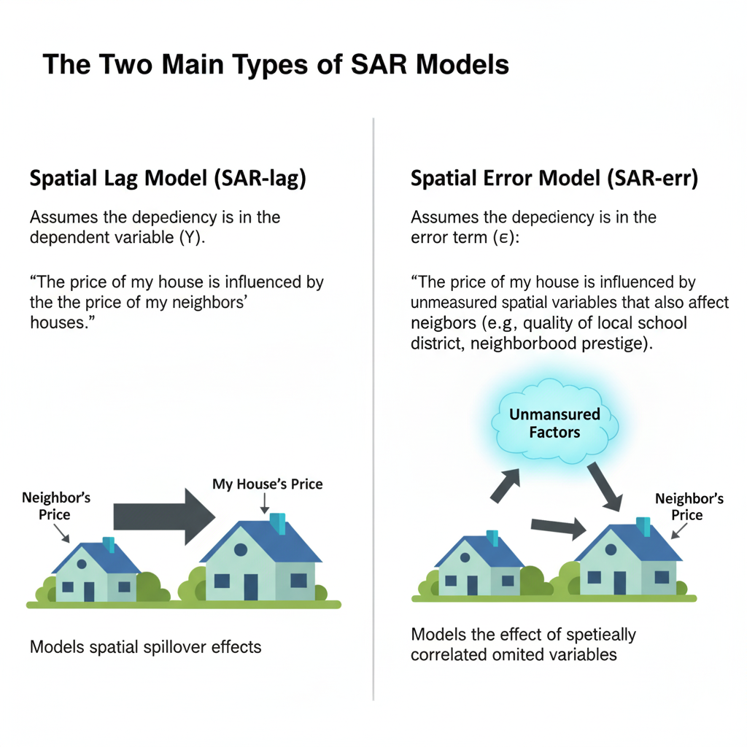
The Two Main Types of SAR Models
1. Spatial Lag Model (SAR-lag): Assumes the dependency is in the dependent variable (Y).
"The price of my house is influenced by the price of my neighbors' houses."
Models spatial spillover effects.
2. Spatial Error Model (SAR-err): Assumes the dependency is in the error term (ε).
"The price of my house is influenced by unmeasured spatial variables that also affect my neighbors (e.g., quality of local school district, neighborhood prestige)."
Models the effect of spatially correlated omitted variables.

Slide 23
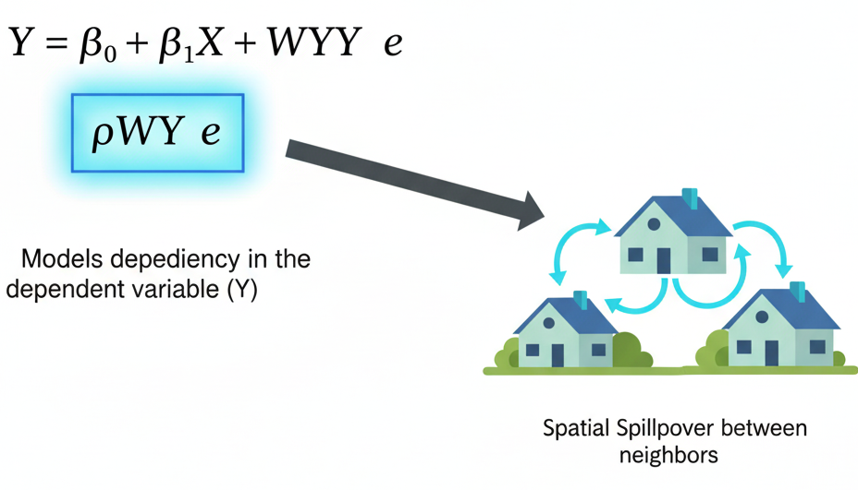
The Spatial Lag Model Equation
Title: Modeling Spillover
Equation: Y = ρWY + βX + ε
Key Terms:
WY: The spatial lag of the dependent variable Y. It's the average value of Y in the neighborhood of each location.
ρ (rho): The spatial autoregressive coefficient. It measures the strength and direction (+ or -) of the spatial spillover. If ρ is significant, it means spatial dependence is important.

Slide 24
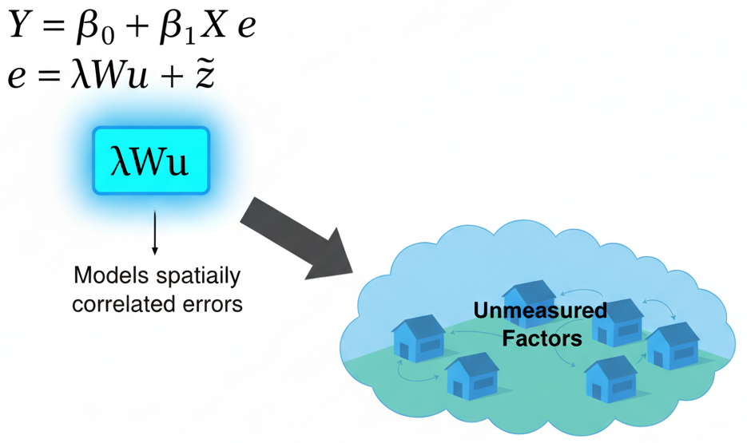
The Spatial Error Model Equation
Title: Modeling Spatial Noise
Equation: Y = βX + u, where u = λWu + ε
Key Terms:
The error term u is itself spatially dependent.
λ (lambda): The spatial error coefficient. It measures the strength of the spatial autocorrelation in the residuals. If λ is significant, it means there are unmeasured variables that are spatially structured.

Slide 25
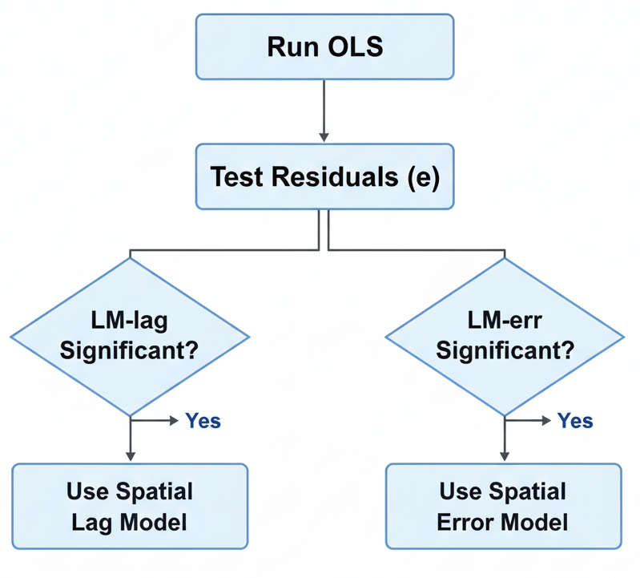
How to Choose Between Lag and Error Models?
Theoretical: Does your theory suggest a spillover process (lag) or omitted variables (error)?
Statistical Tests:
Run a standard OLS regression first.
Examine the residuals (the errors).
Use diagnostics like the Lagrange Multiplier tests (LM-lag, LM-err).
A significant LM-lag test suggests a Spatial Lag model is more appropriate.
A significant LM-err test suggests a Spatial Error model.

Slide 26
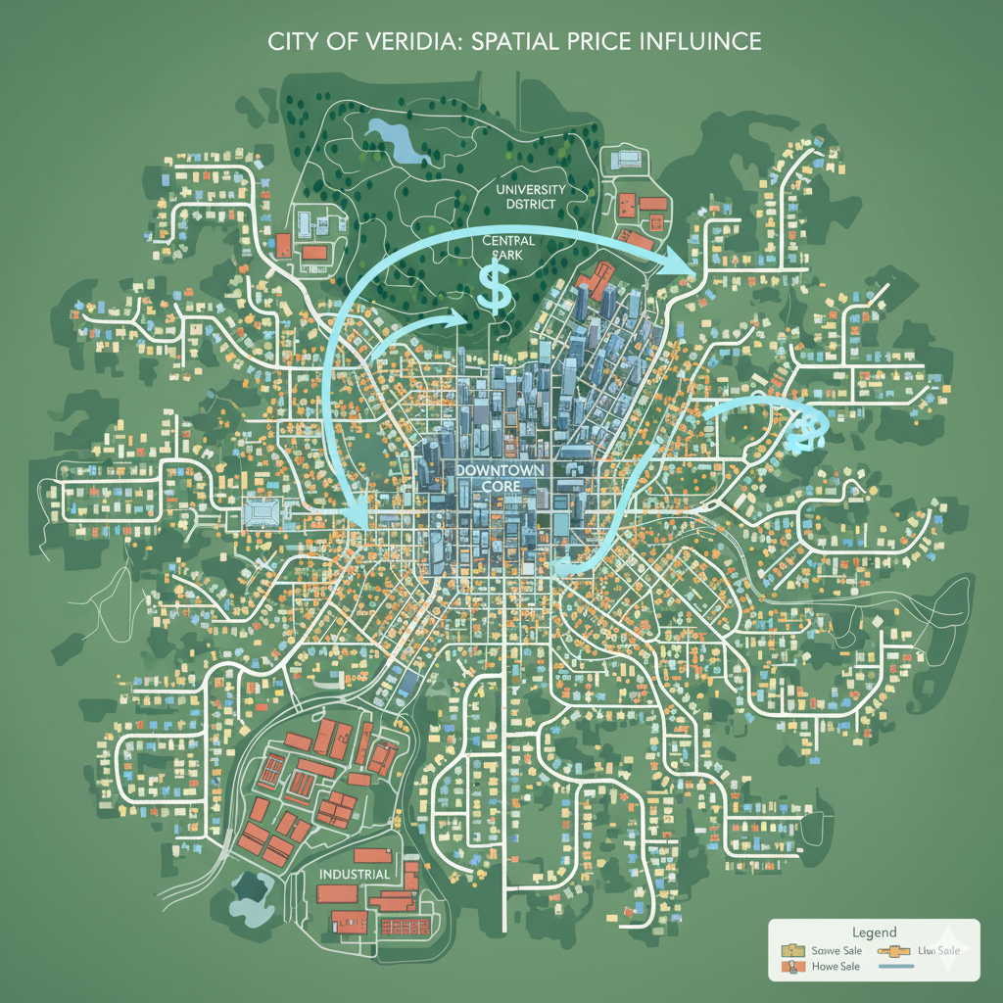
Case Study Revisited: House Prices with SAR
Objective: Model house prices, but this time, explicitly account for neighborhood spillover.
Hypothesis: The price of a house is directly influenced by the sale prices of nearby houses (a classic spillover effect). This points to a Spatial Lag Model.

Slide 27
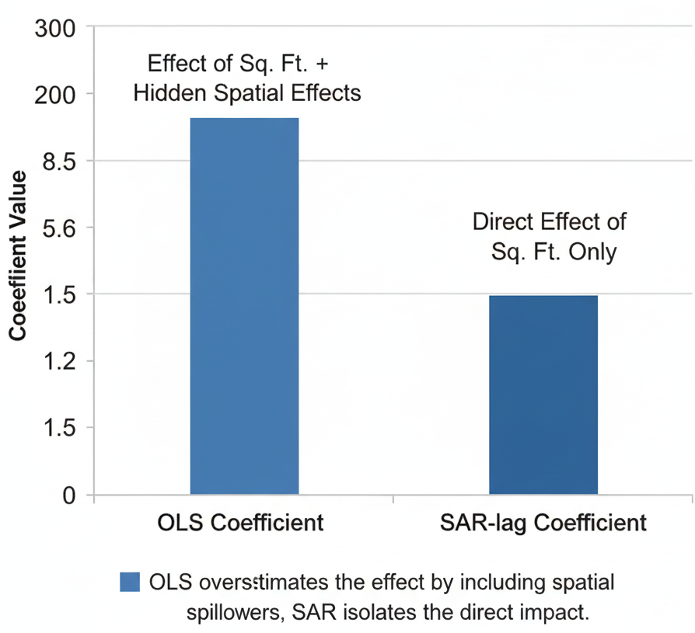
Interpreting SAR vs. OLS Coefficients
Key Insight: The β coefficients in a SAR model represent the direct impact of a variable change at location i on the outcome at location i.
The total impact includes this direct effect PLUS indirect spillover effects that bounce around the neighborhood, captured by the ρ term.
Often, the absolute magnitude of β coefficients will be smaller in a SAR model than in OLS because some of their explanatory power has been correctly attributed to the spatial term (ρWY).

Slide 28
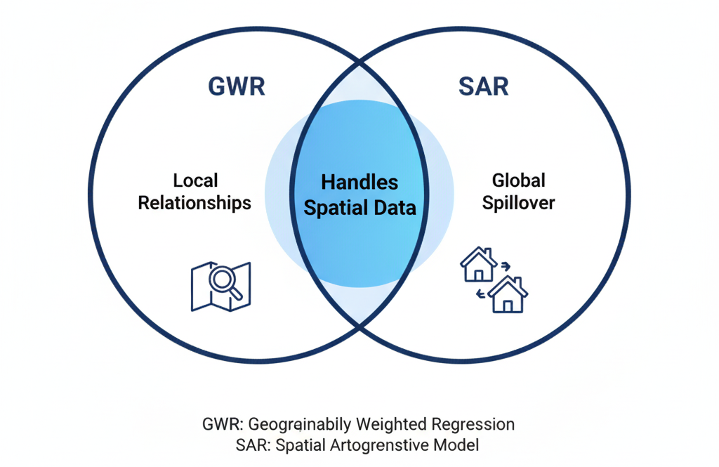
GWR vs. SAR: A Comparison

Slide 29
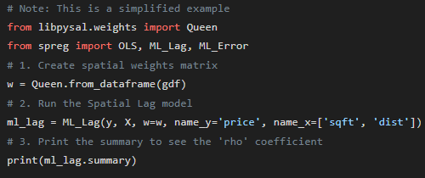
Python Code Snippet: Running a SAR Model
SAR Models with the pysal library

Slide 30
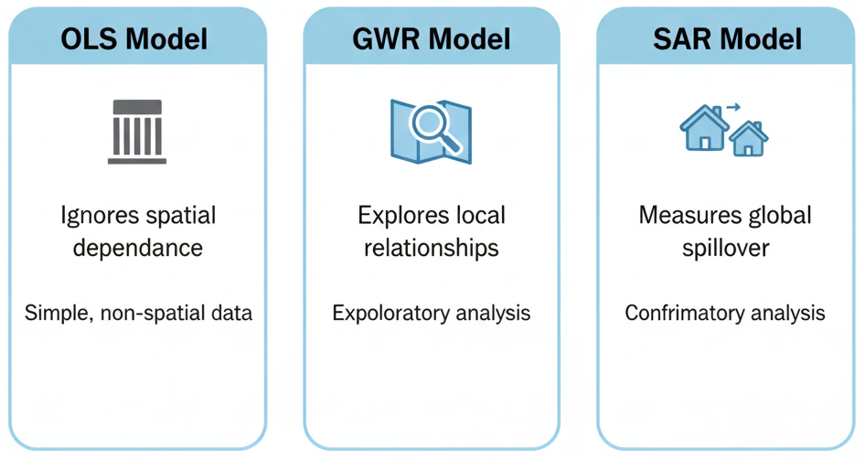
Summary of Spatial Regression
Standard OLS is often inappropriate for spatial data because it ignores spatial dependence.
GWR is a powerful exploratory tool that lets us see where relationships are stronger or weaker.
SAR models are confirmatory tools that explicitly measure the strength of spatial spillover (lag) or spatial nuisance (error).
Choosing the right model depends on your research question and the underlying spatial processes.

Slide 31
Spatial Classification Models

Slide 32
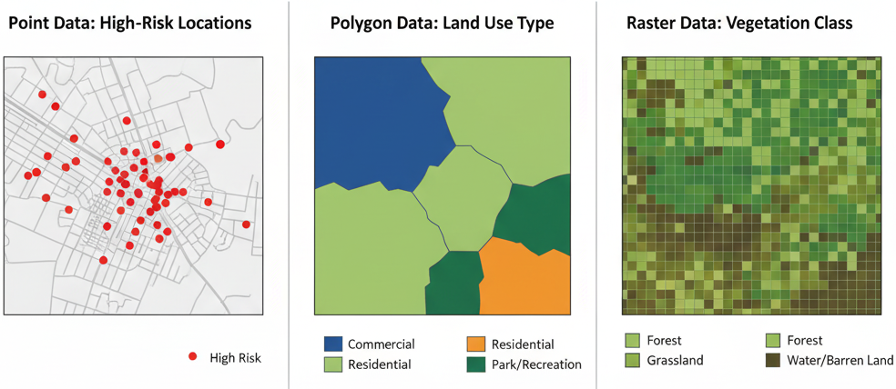
What is Spatial Classification?
Definition: A supervised learning task where the goal is to predict a categorical label for a geographic feature.
It answers questions like:
Is this plot of land going to be residential, commercial, or industrial?
Is this specific pixel in a satellite image showing forest, water, or bare soil?
Is this neighborhood at high, medium, or low risk for wildfire?

Slide 33
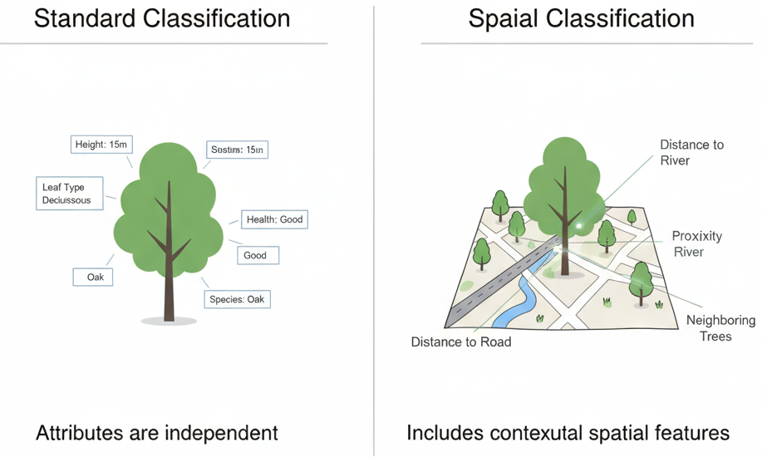
The "Spatial" in Spatial Classification
Standard Classification: Uses only the attributes of the feature itself.
Example: Classifying a tree's health based only on its height and leaf_color.
Spatial Classification: Uses the feature's attributes PLUS its spatial context.
Example: Classifying a tree's health based on its height, leaf_color, AND its distance_to_road, proximity_to_factories, and the average_health_of_neighboring_trees.

Slide 34
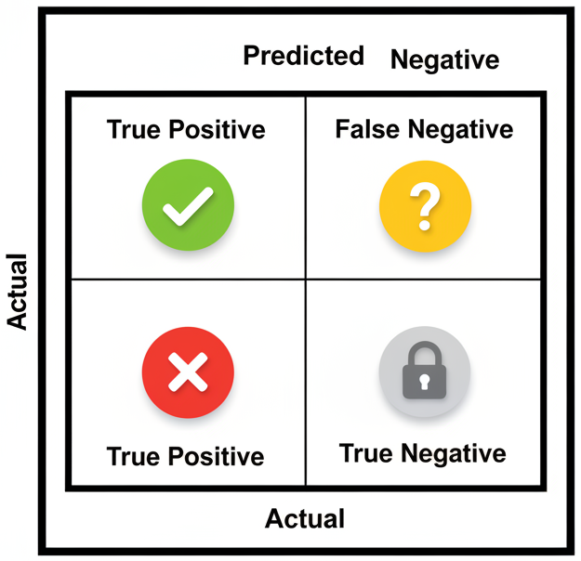
Evaluating Classification Models: A Quick Recap
Confusion Matrix: A table summarizing the performance of a classification model.
Key Metrics:
Accuracy: Overall, how often is the classifier correct?
Precision: When it predicts a class, how often is it right? (Minimizes false positives).
Recall: Of all the actual instances of a class, how many did it find? (Minimizes false negatives).
F1 Score: The harmonic mean of Precision and Recall, useful for imbalanced classes.

Slide 35
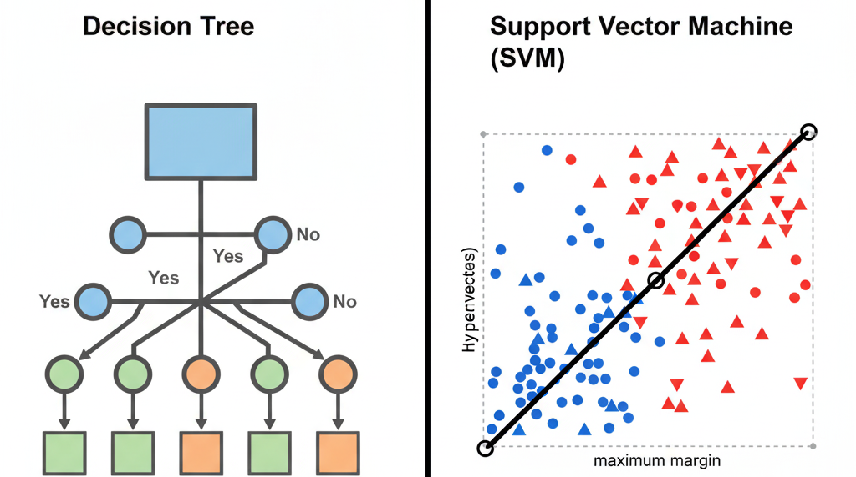
Models We Will Cover
Spatial Decision Trees and Random Forests: Intuitive, powerful, and excellent at handling a mix of different data types.
Support Vector Machines (SVMs) for Spatial Data: A powerful method known for its effectiveness in high-dimensional spaces.

Slide 36
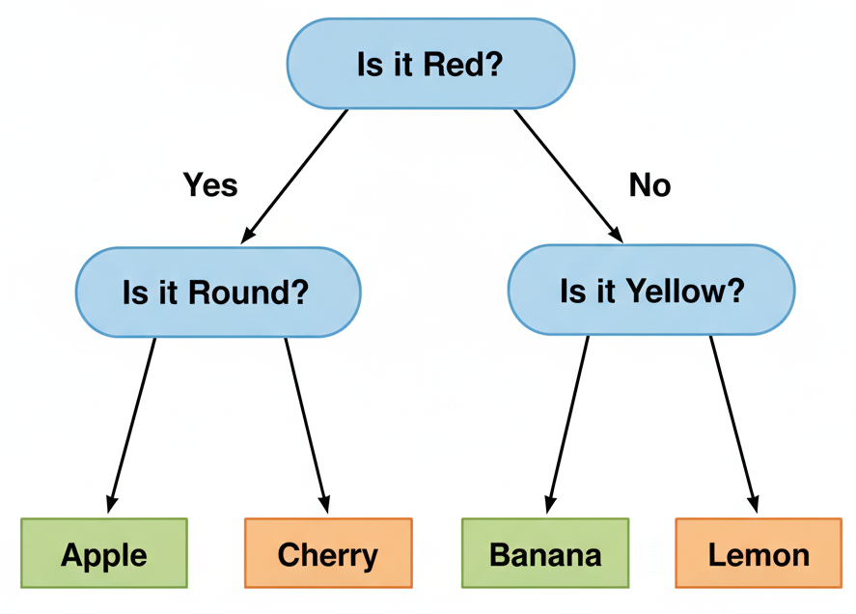
Introduction to Decision Trees
Concept: A flowchart-like structure where each internal node represents a "test" on a feature (e.g., "Is Elevation > 500m?"), each branch represents the outcome of the test, and each leaf node represents a class label.
How it Works: The algorithm learns a sequence of "if-then-else" questions to split the data into the purest possible groups.

Slide 37
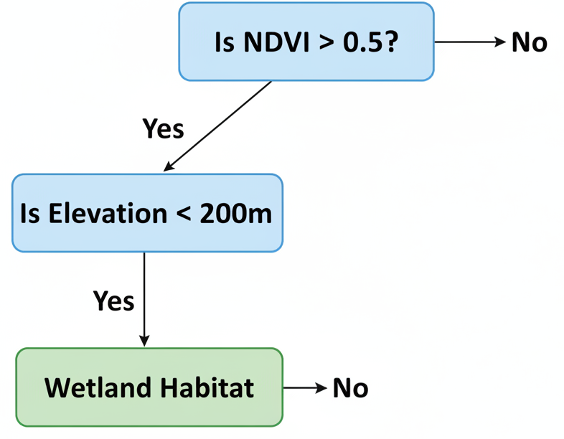
Making a Decision Tree "Spatial"
The Strategy: The tree itself doesn't need to change. The magic lies in the features we provide it.
We can create splits based on spatial features:
"Is Dist_to_River < 50 meters?"
"Is w_Population_Density (spatial lag) > 1000 people/km²?"
"Is Crime_Count_in_Buffer > 5?"
By doing this, the tree learns to make decisions based on geographic context.

Slide 38
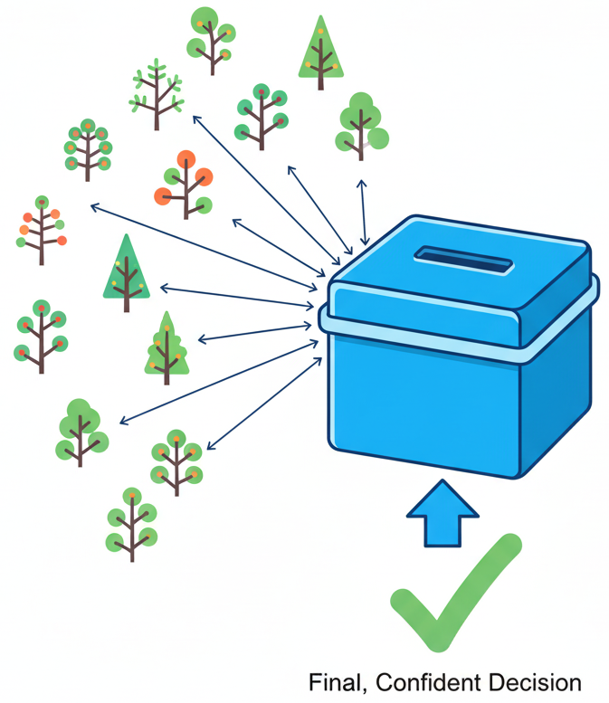
From One Tree to a Random Forest
The Problem with Single Trees: They can be prone to overfitting—learning the training data too well, including its noise, and failing to generalize to new data.
The Solution: Random Forest: An ensemble method. It builds hundreds or thousands of different decision trees, each on a random subset of the data and features.
The Prediction: To classify a new point, it gets a vote from every tree in the forest. The class with the most votes wins. This "wisdom of the crowd" approach is more robust and accurate.

Slide 39
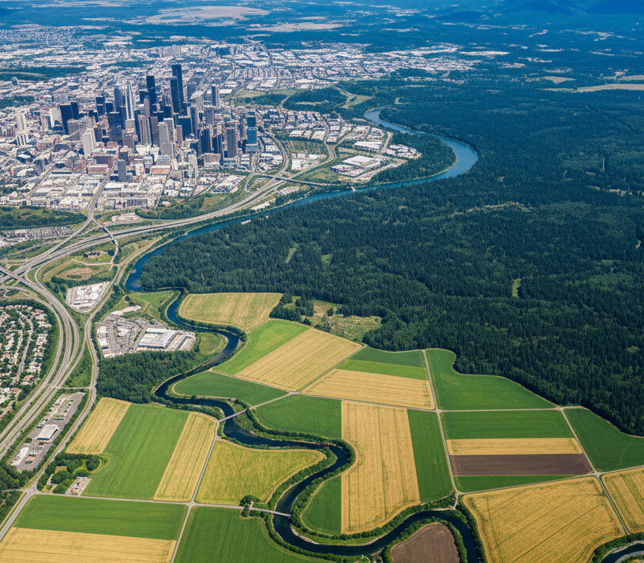
Case Study: Land Use Land Cover (LULC) Classification
Objective: To create a LULC map from a multi-spectral satellite image.
Data: A satellite image where each pixel is a data point.
Classes: Urban, Forest, Water, Agriculture.
Task: Classify every pixel into one of these four classes using a Random Forest model.

Slide 40
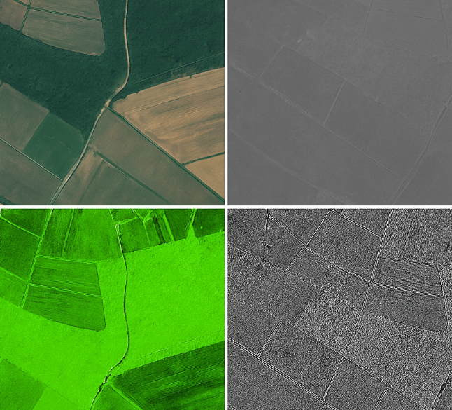
LULC Case Study: Feature Engineering
Feature Type | Example Features | Rationale
Spectral | Red Band Value, Green Band, Blue Band, Near-Infrared (NIR) | Different materials (e.g., plants, concrete) reflect light differently.
Derived Indices | NDVI = (NIR−Red)/(NIR+Red) | Normalized Difference Vegetation Index is a strong indicator of healthy vegetation.
Spatial / Textural | Standard deviation of NIR in a 5×5 window around the pixel | Measures texture. A forest has high texture, while a calm lake has low texture.
Ancillary | Elevation, Slope (from a DEM) | Agriculture is usually on flat land; certain forests grow at high elevations.

Slide 41
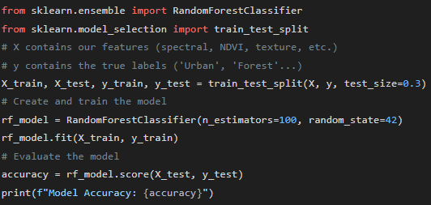
Python Code Snippet: Training a Random Forest

Slide 42
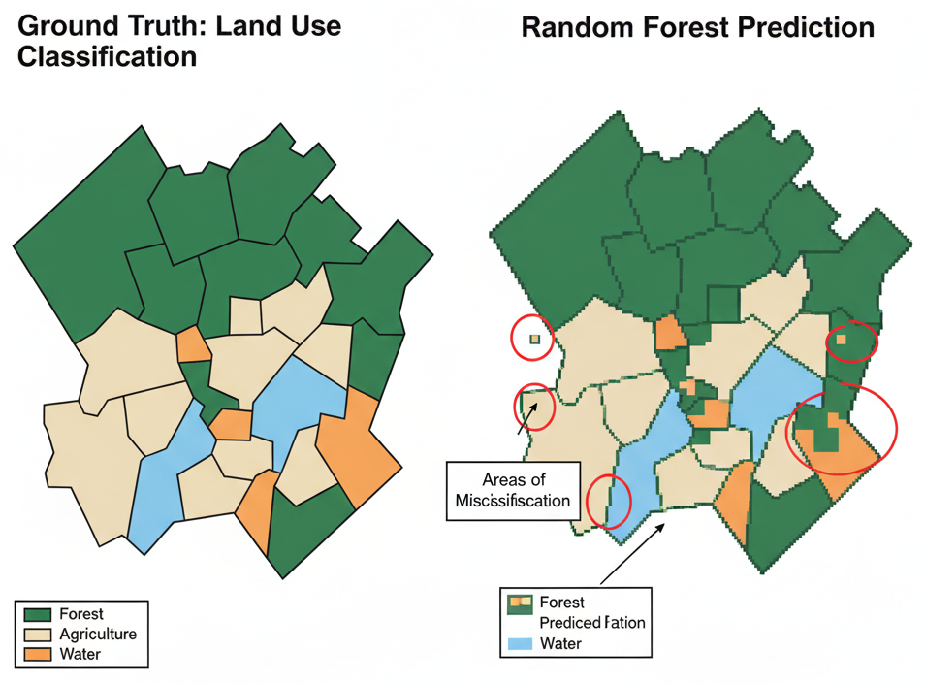
LULC Case Study: Results
Visualization: A side-by-side comparison.
Left: The original, ground-truth LULC map.
Right: The LULC map predicted by our Random Forest model.
Discussion: Point out areas where the model did well (e.g., distinguishing water from forest) and where it struggled (e.g., distinguishing low-density urban from agriculture).

Slide 43
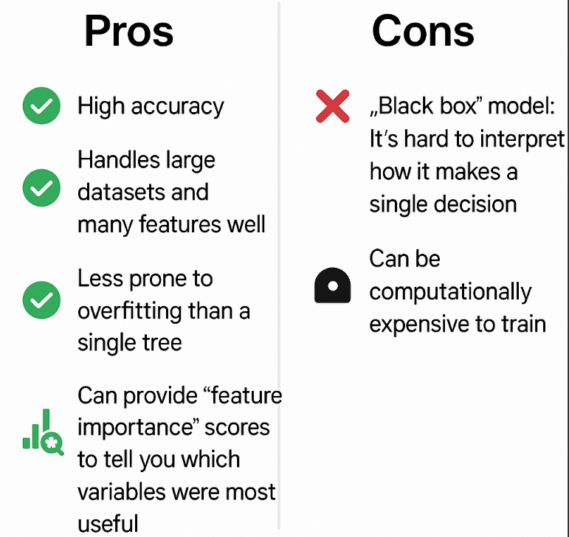
Random Forests: Pros and Cons for Spatial Data

Slide 44
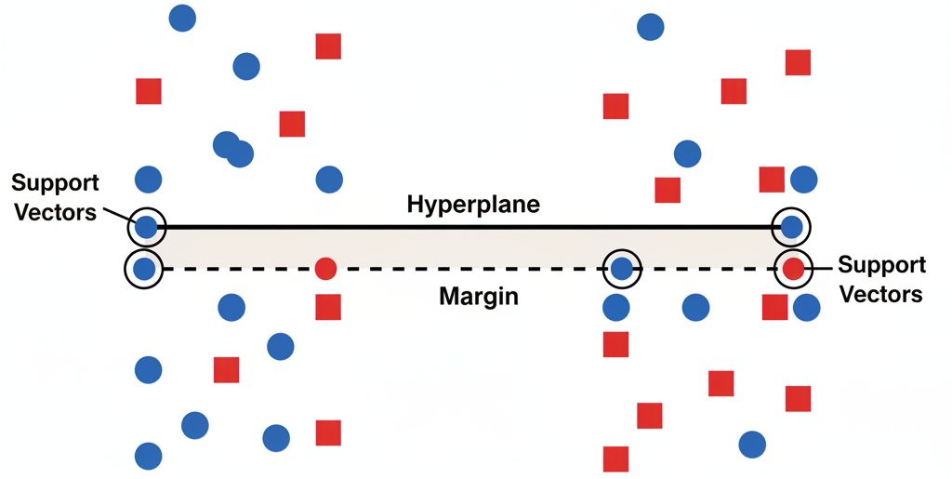
Introduction to Support Vector Machines (SVM)
Core Concept: SVM is a linear classifier that finds the hyperplane (a line in 2D, a plane in 3D) that best separates two classes.
The "Best" Hyperplane: The one that has the largest margin—the distance between the hyperplane and the nearest data point from either class.
These nearest points are called support vectors because they "support" the hyperplane.

Slide 45
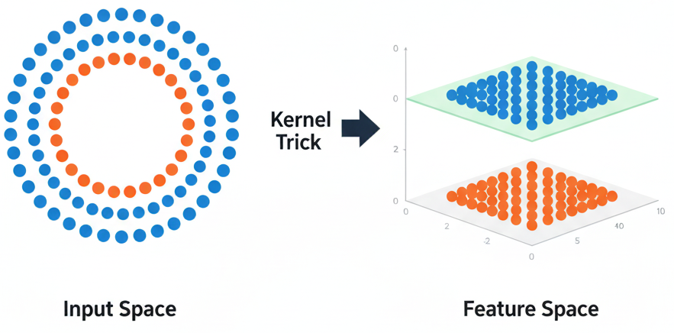
Handling Non-Linear Data: The Kernel Trick
Problem: What if the data isn't linearly separable?
The Kernel Trick: SVM can use a "kernel" to project the data into a higher dimension where it does become linearly separable.
Analogy: Imagine a line of blue and red beads on a table that you can't separate with a single ruler. If you flick the table, launching them into the air (a higher dimension), you can now slide a piece of paper (a hyperplane) between them.
Common Kernels: Linear, Polynomial, Radial Basis Function (RBF).

Slide 46
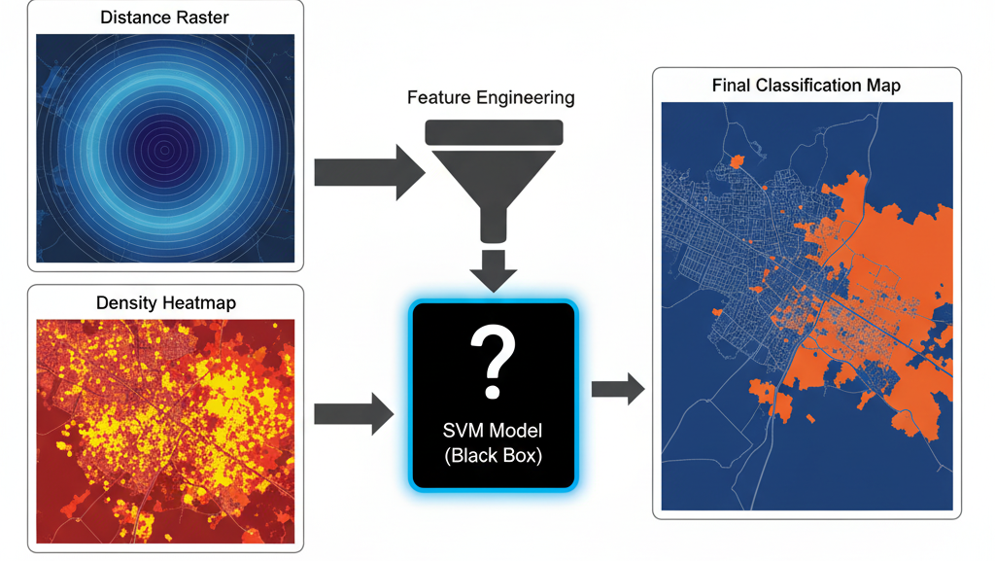
Making an SVM "Spatial"
The Primary Method: Just like with Random Forests, the most common and effective way is through explicit feature engineering.
Feed the SVM a rich set of spatial predictors:
Dist_to_Coast
Buffer_Count_of_Polluters
Spatial_Lag_of_Temperature
Kernel_Density_of_Incidents
The SVM will then learn to define its separating hyperplane using these spatial dimensions.

Slide 47
Application: Wildlife Habitat Suitability Modeling
Objective: To predict where a particular species (e.g., a grizzly bear) is likely to be found (Presence) vs. not found (Absence).
Data: A set of known Presence and Absence locations (points).
Task: Use SVM to classify the entire landscape as either "Suitable" or "Unsuitable" habitat.

Slide 48
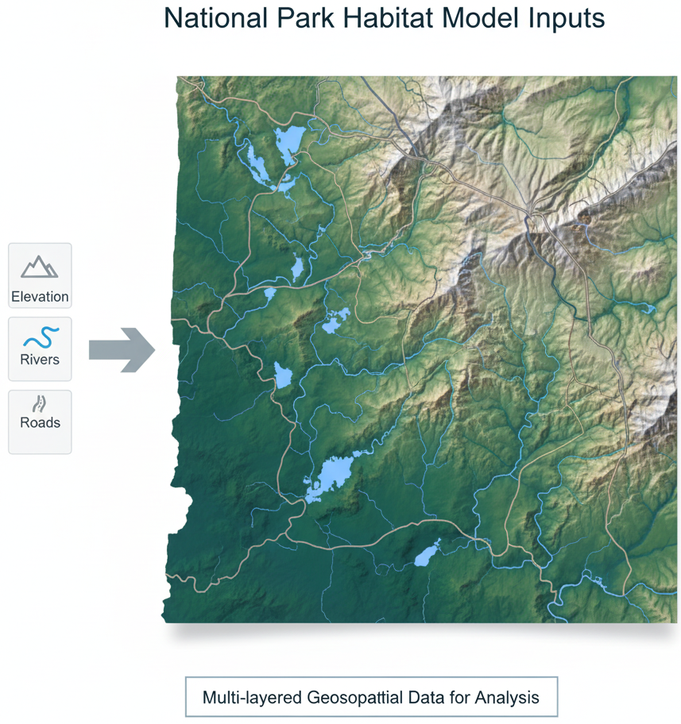
Habitat Modeling: Feature Engineering
Feature Type | Example Features | Rationale for Grizzly Bears
Topographic | Elevation, Slope, Aspect | Bears prefer certain elevation ranges and avoid very steep slopes.
Environmental | Distance_to_Water | A critical resource.
Vegetation | NDVI, Land_Cover_Class | Indicates food availability (berries, etc.) and cover.
Human Impact | Distance_to_Roads, Housing_Density | Bears are conflict-averse and generally avoid humans.

Slide 49
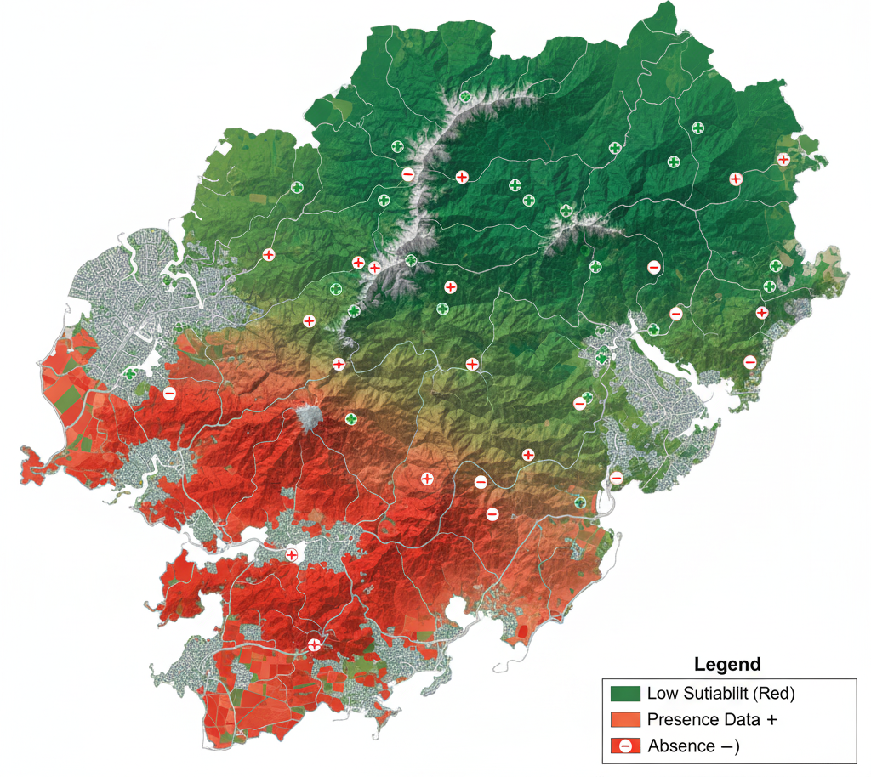
Habitat Modeling: SVM Results
Visualization: A map of the study area colored by the SVM's prediction.
Green: "Suitable Habitat" (Predicted Presence)
Red: "Unsuitable Habitat" (Predicted Absence)
Interpretation: The model identifies remote, high-elevation areas near water and far from roads as suitable, which aligns with our ecological knowledge of the species.

Slide 50
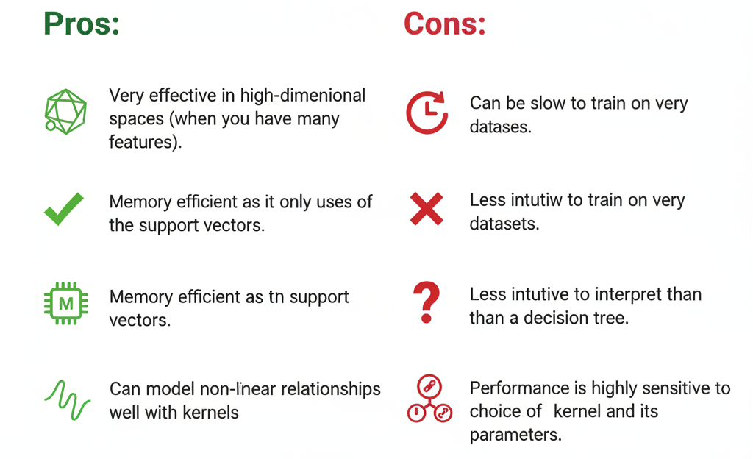
SVMs: Pros and Cons for Spatial Data

Slide 51
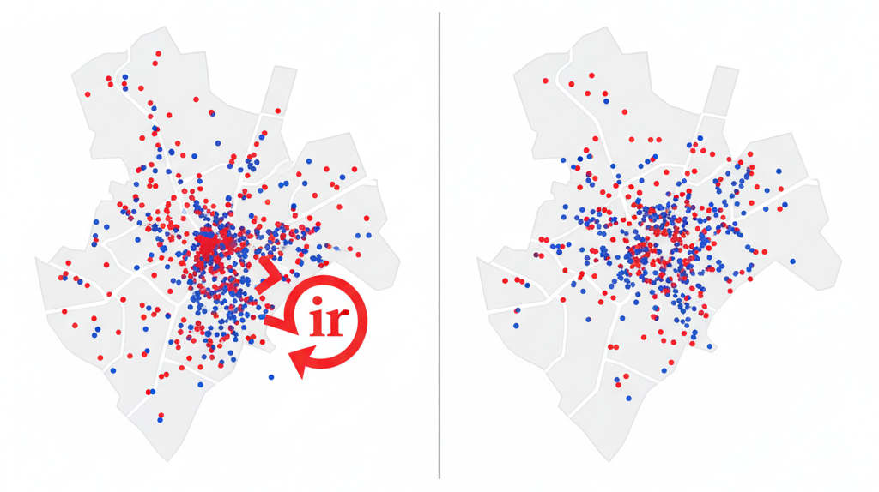
A Critical Topic: Evaluating Spatial Models
Problem: If we use standard k-fold cross-validation, we might be cheating.
Why? Due to spatial autocorrelation, a training point at location A is very similar to a testing point at nearby location B. The model isn't really learning to generalize; it's just learning from a near-duplicate. This leads to overly optimistic performance estimates.

Slide 52
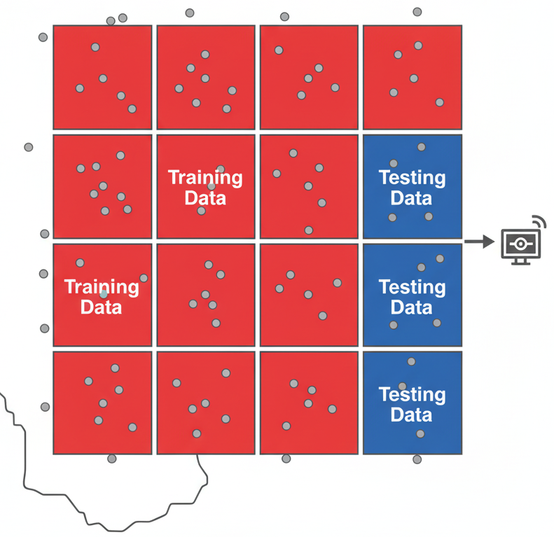
The Solution: Spatial Cross-Validation
Concept: We must ensure that our training and testing sets are spatially separated.
Method: Block Cross-Validation: Divide the study area into geographic "folds" or blocks. In each iteration, use some blocks for training and a completely separate block for testing.
This forces the model to predict for areas it has no nearby information about, giving a more realistic measure of its performance in the real world.

Slide 53
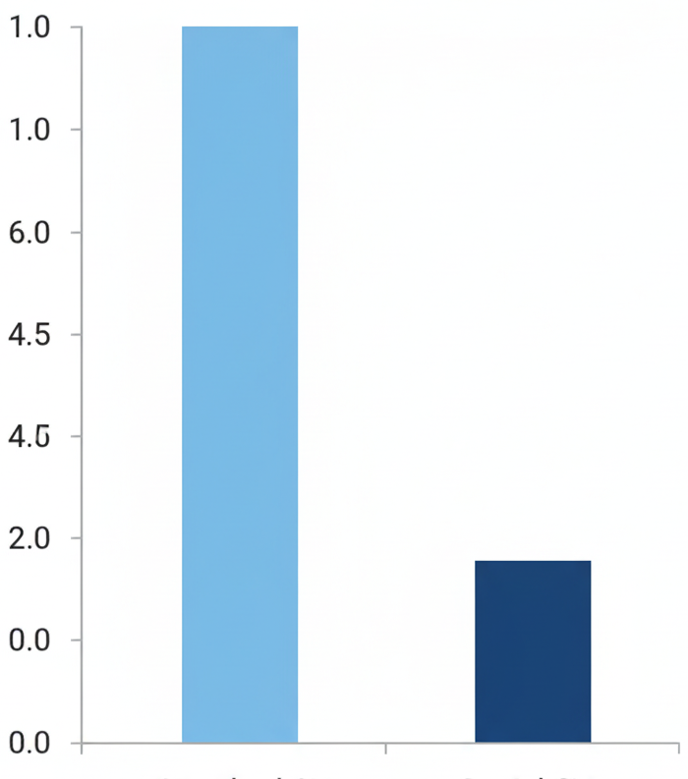
Spatial vs. Standard CV: The Impact
Metric | Standard CV Result | Spatial CV Result
Accuracy | 0.92 (Optimistic) | 0.78 (Realistic)
Takeaway: Always use a spatial cross-validation strategy when evaluating a model built with spatial data. Your reported accuracy will be lower, but it will be an honest reflection of your model's true predictive power.
Standard CV Spatial CV

Slide 54
Summary of Spatial Classification
Spatial classification is about predicting categories for geographic features.
The key to making classifiers "spatial" is to feed them features that encode spatial context (distance, density, neighborhood stats).
Random Forests are robust, accurate, and provide feature importance.
SVMs are powerful for non-linear problems with many features.
Crucially, you must use Spatial Cross-Validation to get an honest assessment of your model's performance.

Slide 55
Spatial Clustering Techniques

Slide 56
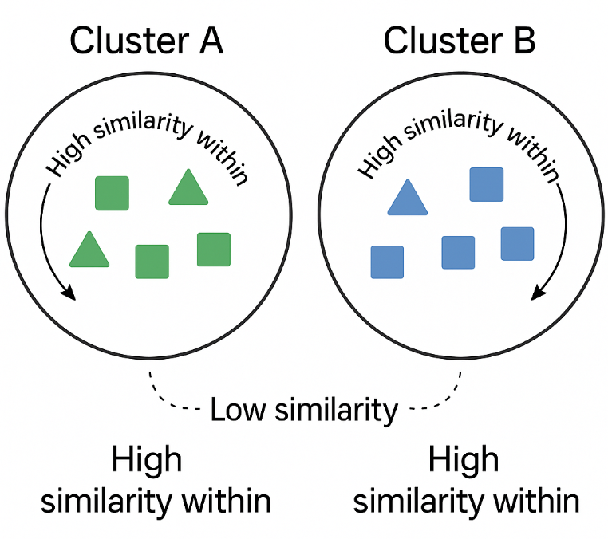
What is Spatial Clustering? (Unsupervised Learning)
Definition: The process of grouping a set of geographic objects into clusters, such that objects in the same cluster are more similar to each other than to objects in other clusters.
It's Unsupervised: We don't provide the algorithm with any "right answers" or labels. It discovers the patterns on its own.
Key Idea: The goal is to maximize intra-cluster similarity and minimize inter-cluster similarity.

Slide 57

Why is "Spatial" Clustering Different?
Standard Clustering: Groups data based only on its attributes.
Example: Clustering houses based only on price and square_footage. You might find a cluster of "large, expensive homes."
Spatial Clustering: Groups data based on its attributes AND its geographic location.
Example: Clustering houses based on price, square_footage, AND their coordinates. You would find geographically contiguous clusters of "large, expensive homes in the western suburb" and "small, expensive condos downtown."

Slide 58

Models We Will Cover
Partitioning Methods: K-Means and its spatial extensions (dividing data into a pre-defined number of clusters).
Density-Based Methods: DBSCAN and OPTICS (finding arbitrarily shaped clusters based on how tightly packed points are).
Hierarchical Methods: Hierarchical Clustering (building a tree of nested clusters).

Slide 59

Introduction to K-Means Clustering
Concept: A simple and popular partitioning algorithm.
Objective: To partition n data points into k pre-defined clusters.
How it Works (Simplified):
Choose k: You decide how many clusters you want to find.
Initialize: Randomly place k centroids on your data space.
Assign: Assign each data point to its nearest centroid.
Update: Move each centroid to the average position of all the points assigned to it.
Repeat: Repeat steps 3 and 4 until the centroids stop moving.

Slide 60

The Limitation of Standard K-Means for Spatial Data
The Problem: Standard K-Means is spatially blind. It only considers attribute similarity.
If you give it latitude and longitude as features, it will find purely geographic clusters.
If you give it only attributes like income, it will ignore geography completely.
The Result: It often produces clusters that are geographically fragmented and not meaningful for spatial analysis.

Slide 61

Application: Creating Market Zones
Objective: A retail company wants to divide a city into 5 distinct market zones for targeted advertising.
Data: Census tracts (polygons) with demographic data (avg_income, population_density, %_with_kids).
Task: Use Spatially Constrained K-Means (k=5) to create 5 geographically contiguous zones that are as demographically homogeneous as possible.

Slide 62

K-Means: Pros and Cons
Pros:
Simple to understand and implement.
Computationally efficient and scales to large datasets.
Cons:
You must specify the number of clusters (k) in advance.
Struggles with non-spherical clusters and varying densities.
Sensitive to the initial random placement of centroids.

Slide 63

Introduction to DBSCAN
Title: Density-Based Spatial Clustering of Applications with Noise
Concept: A completely different approach. It defines clusters as continuous regions of high point density, separated by regions of low density.
Key Advantage:
It does NOT require you to specify the number of clusters.
It can find arbitrarily shaped clusters (not just circles).
It can explicitly identify points that don't belong to any cluster, labeling them as noise.

Slide 64

How DBSCAN Works: The Core Concepts
Two Key Parameters:
ε (Epsilon): A distance radius. "What is my search radius for neighbors?"
MinPts (Minimum Points): A density threshold. "How many neighbors must I find within my ε radius to be considered a dense region?"
Point Types:
Core Point: Has at least MinPts neighbors within its ε radius. These are the hearts of clusters.
Border Point: Is a neighbor of a Core Point but doesn't have enough neighbors itself. These are the edges of clusters.
Noise Point: Neither a Core nor a Border point. These are the outliers.

Slide 65

The DBSCAN Algorithm (Conceptual)

Slide 66

Case Study: Discovering Crime Hotspots
Objective: Identify clusters of crime incidents in a city to guide police patrols.
Data: A point layer of thousands of recorded theft incidents.
Task: Use DBSCAN to find dense hotspots. The arbitrary shapes are perfect for this, as hotspots can follow roads or be in parks. The noise identification is also useful for filtering out isolated, random incidents.

Slide 67

Crime Hotspots: Running DBSCAN
Parameter Choice:
ε = 100 meters: We'll consider incidents within a block of each other as neighbors.
MinPts = 10: An area needs to have at least 10 incidents to be considered a significant hotspot.
Python Code Snippet (scikit-learn)

Slide 68

Crime Hotspots: Interpreting the Results
Visualization: A map of the city with the theft incidents colored by their DBSCAN cluster label.
Interpretation:
A large, oddly-shaped red cluster appears over the downtown entertainment district.
A smaller blue cluster is centered on a major shopping mall.
Many isolated points are colored gray, identified as noise, and can be considered lower priority.

Slide 69

The Challenge of DBSCAN: Epsilon (ε)
The Hard Part: The results of DBSCAN are highly sensitive to the choice of ε.
A small ε will result in many small clusters; a large ε will merge everything into one big cluster.
How to choose ε? A common heuristic is to use a k-distance graph. You calculate the distance to the k-th nearest neighbor (where k = MinPts) for every point, sort these distances, and plot them. The "elbow" or "knee" of this plot is often a good guess for ε.

Slide 70

Introduction to OPTICS
Title: Ordering Points To Identify the Clustering Structure
Concept: An extension of DBSCAN that addresses the ε problem.
How it Works: OPTICS doesn't produce clusters directly. Instead, it creates an augmented ordering of the data points. This ordering represents the density-based clustering structure.
You can then extract clusters for any ε value from this single ordering, without re-running the algorithm.

Slide 71

The OPTICS Reachability Plot
Concept: This is the primary output of OPTICS. It's a bar chart showing the "reachability distance" for each point in the OPTICS ordering.
Interpretation:
Valleys in the plot correspond to clusters.
Peaks correspond to the separations between clusters.
The deeper the valley, the denser the cluster.
This plot gives you a powerful visual summary of the density structure of your entire dataset.

Slide 72

DBSCAN vs. OPTICS
Feature | DBSCAN | OPTICS
Parameters | ε and MinPts | Only MinPts (and a max ε)
Output | A single set of clusters | A reachability plot (cluster ordering)
Flexibility | Inflexible; requires re-running for new ε | Very flexible; can extract clusters for any ε from one run
Use Case | When you have a good idea of the density/scale | When you want to explore clusters at multiple scales

Slide 73

Introduction to Hierarchical Clustering
Concept: A clustering method that builds a hierarchy of clusters.
Two Main Types:
Agglomerative (Bottom-Up): Starts with each point as its own cluster and progressively merges the closest pairs of clusters until only one is left.
Divisive (Top-Down): Starts with one giant cluster and recursively splits it until each point is its own cluster. (Agglomerative is more common).
A

Slide 74

The Dendrogram
Concept: The output of a hierarchical clustering is a tree-like diagram called a dendrogram.
How to Read It:
The leaves at the bottom are the individual data points.
As you move up, lines merge, representing clusters being merged.
The height of the merge represents the distance (or dissimilarity) between the two clusters that were joined.
The Power: You can "cut" the dendrogram at any height to get a specific number of clusters.

Slide 75

Making Hierarchical Clustering "Spatial"
The Method: Similar to K-Means, we can apply a spatial contiguity constraint.
Spatially Constrained Hierarchical Clustering: The algorithm works the same (agglomerative merging), but with a new rule: two clusters can only be merged if they are geographically adjacent.
This is very useful for creating nested regions, like a hierarchy of neighborhood -> district -> city quadrant.

Slide 76

Application: Creating Ecological Zones
Objective: To define a hierarchy of ecological regions based on environmental variables.
Data: A grid of cells, each with data on temperature, precipitation, and soil_type.
Task: Use spatially constrained hierarchical clustering to group adjacent cells with similar environmental profiles.
Result: A dendrogram and a map that can be cut to show, for example, 3 broad "Eco-Regions," which can then be broken down into 10 smaller "Sub-Regions."

Slide 77
Summary of Clustering Algorithms
Algorithm | Key Idea | When to Use It
K-Means | Partitioning around k centroids | When you know how many clusters you want and they are roughly spherical.
DBSCAN | Density-based connectivity | When you have noise, don’t know k, and clusters may be oddly shaped.
OPTICS | Cluster ordering for variable densities | When you want to explore the density structure at multiple scales without re-running.
Hierarchical | Building a tree of nested clusters | When you need a hierarchy of regions or want to see how data groups at different scales.

Slide 78
Chapter 3 Summary
Main Takeaway: Standard ML algorithms are often insufficient for spatial data. We need specialized algorithms that can correctly model spatial phenomena.
Spatial Regression (GWR, SAR): Helps us understand how relationships vary across space and how features influence their neighbors.
Spatial Classification (Spatial RF, SVM): Allows us to predict categories for locations by leveraging powerful spatial features.
Spatial Clustering (DBSCAN, Constrained K-Means): Lets us discover hidden, geographically meaningful groups in our data without needing labels.

Slide 79

Myself
Dr. Giri Rajasekhar Gunnu
AI, Digital Twin & Industry Solutions Specialist | Industry 4.0 Specialist | Predictive Solutions Expert | Marine and Offshore Consultant
Professor of Practice, Andhra University
📧 g.giri.iitm@gmail.com
🔗 LinkedIn: girigunnu

Slide 80
Q&A
Welcome your questions and insights from all ranks
Your feedback helps us improve our CBPM implementation and ensures it meets the real-world needs of our fleet

